Slide 1
HiWi Reports
| Haochen Zhang | 11.05.2026

Slide 2
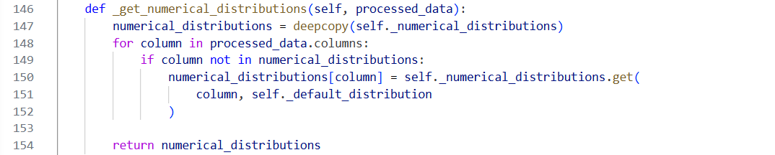
Date and timestamp do not match after anonymization
Row 146 _get_numerical_distributions(self, processed_data): Column-wise distribution choice. it decides which univariate distribution each column will use when the Gaussian copula model is fitted.
Date and timestamp columns as separate variables during preprocessing and synthesis.
| Haochen Zhang | 11.05.2026

Slide 3
Filtered Data has higher overall score
Data comparison
Original Data:
Number of rows: 2871
Location: Logistic Centre, Atlantis waterpark
Energy source: Electricity, District heating, Water supply (network), Water supply(well), Water supply
Filtered Data:
Number of rows: 862
Location: Logistic Centre
Energy source: Electricity
| Haochen Zhang | 11.05.2026

Slide 4
Filtered Data has higher overall score
Type to filter
Location: Logistic Centre
Energy Source: Electricity
Overall score
Without filter
CTGAN quality score: 0.7874419279907086
Gaussian quality score: 0.7216124661246612
With filter
CTGAN quality score:0.8675412237859502
Gaussian quality score: 0.8298054267298535
| Haochen Zhang | 11.05.2026

Slide 5
Compare 3 columns
Related columns in tables(date and timestamps are generated independently)
Sdtype (faker lib, replace items list(how to generate)) not exist in sdtypes (LLM)
| Haochen Zhang | 11.05.2026

Slide 6
SMX Table
 | Actor_type | City | Country | GPS | Project | RBAC | Service | User_name | SMXtimestamp
Me | 0 | 0 | 0 | 1 | 0 | 0 | 0 | 1 | 1
PII Scan | 0 | 0 | 1 – 0.85 | 1 – 0.01 | 1 – 0.30 | 0 | 0 | 0 | 1 – 0.85
LLM | 0 – 0.20 | 1 – 0.80 | 1 – 0.70 | 1 – 0.90 | 0 - 0.25 | 0 - 0.25 | 0 – 0.20 | 1 – 1.00 | 1 – 0.10
0 – not necessary
1 – must
Confidence score
City, country, GPS
| Haochen Zhang | 11.05.2026

Slide 7
Sampledata
 | Date | Timestamp | Location | Energy Source | Measure | Unit of Measure | Interval | Value
Me | 1 | 1 | 1 | 1 | 0 | 0 | 0 | 0
PII Scan | 1 – 0.60, 0.85 | 1 | 0 | 0 | 0 | 1 – 0.30 | 0 | 1 – 0,40
LLM | 1 – 0.93 | 1 – 0.95 | 1 – 0.92 | 1 – 0.70 | 1 – 0.78 | 0 – 0.35 | 0 – 0.40 | 0 – 0.50
0 – not necessary
1 – must
Confidence score
| Haochen Zhang | 11.05.2026

Slide 8
Weather data
 | feeder | timestamp_UTC | timestamp_CET_CEST | direct_radiation_W/m2 | diffuse_radiation_W/m2 | air_temperature_C | precipitation_kg/m2 | snow_height_m | humidity_kg/kg | max_wind_gust_m/s | meridional_wind_m/s | zonal_wind_m/s
Me | 1 | 1 | 1 | 0 | 0 | 0 | 0 | 0 | 0 | 0 | 0 | 0
PII Scan | 0 | 1 – 0.85 | 1 | 1 | 1 | 1 | 1 | 1 | 1 | 1 | 1 | 1
LLM | 1 – 0.95 | 0 – 0.35 | 0 – 0.35 | 0 – 0.10 | 0 – 0.10 | 0 – 0.10 | 0 – 0.10 | 0 – 0.10 | 0 – 0.10 | 0 – 0.10 | 0 – 0.10 | 0 – 0.10
0 – not necessary
1 – must
Confidence score
| Haochen Zhang | 11.05.2026

Slide 9
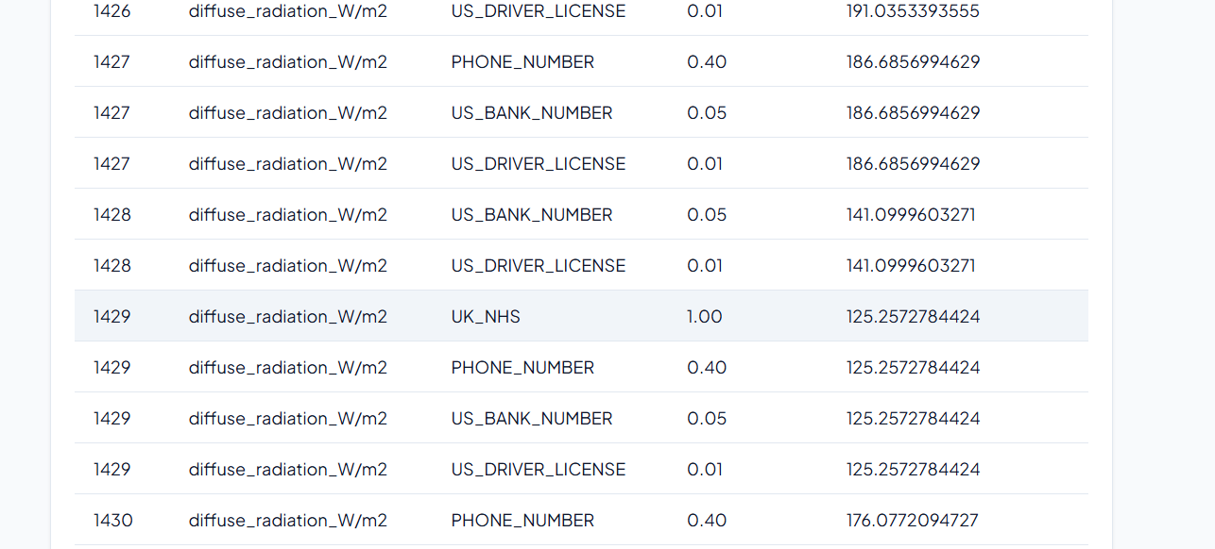
Weather Data
| Haochen Zhang | 11.05.2026

Slide 10
Weather data given PD
 | feeder | timestamp_UTC | timestamp_CET_CEST | direct_radiation_W/m2 | diffuse_radiation_W/m2 | air_temperature_C | precipitation_kg/m2 | snow_height_m | humidity_kg/kg | max_wind_gust_m/s | meridional_wind_m/s | zonal_wind_m/s
Me | 1 | 1 | 1 | 0 | 0 | 0 | 0 | 0 | 0 | 0 | 0 | 0
LLM | 1 – 0.70 | 0 – 0.20 | 0 – 0.20 | 0 – 0.00 | 0 – 0.00 | 0 – 0.00 | 0 – 0.00 | 0 – 0.00 | 0 – 0.00 | 0 – 0.00 | 0 – 0.00 | 0 – 0.00
0 – not necessary
1 – must
Confidence score
1. **DPV‑Definition von personenbezogenen Daten**
DPV unterscheidet klar zwischen *personenbezogenen* und *nicht‑personenbezogenen* Daten.
Daten gelten als personenbezogen, wenn sie einer *identifizierten* oder *identifizierbaren* natürlichen Person zugeordnet werden können.
2. **Identifier‑Kategorie**
In DPV ist ein „Identifier“ (z. B. ID‑Nummer, Gerätename) als personenbezogen klassifiziert, wenn der Identifier in Verbindung mit einer Person steht.
Der *feeder* ist ein möglicher eindeutiger Bezeichner für eine Messstation; wenn diese Station in privatem oder firmeneigenem Besitz ist,
könnte der Identifier zur Identifikation der jeweiligen Person oder des Unternehmens verwendet werden.
3. **Temporal‑ und Location‑Daten**
Zeitstempel (und in Kombination mit Standortdaten) können zur Re‑Identifikation herangezogen werden, wenn genügend Kontext vorhanden ist.
In Ihrem Datensatz gibt es jedoch keine direkten Standortangaben, sodass das Risiko klein ist. Deshalb wird ein niedriger Confidence‑Score gesetzt.
4. **Technische Messdaten**
Alle übrigen Spalten liefern reine physikalische Messwerte (Temperatur, Strahlung, Windgeschwindigkeit, etc.)
und stellen keine direkte oder indirekte Information über eine Person dar. DPV klassifiziert diese als *technische Messdaten* und erfordert keine Anonymisierung.
| Haochen Zhang | 11.05.2026

Slide 11
Weather data given LOC
 | feeder | timestamp_UTC | timestamp_CET_CEST | direct_radiation_W/m2 | diffuse_radiation_W/m2 | air_temperature_C | precipitation_kg/m2 | snow_height_m | humidity_kg/kg | max_wind_gust_m/s | meridional_wind_m/s | zonal_wind_m/s
Me | 1 | 1 | 1 | 0 | 0 | 0 | 0 | 0 | 0 | 0 | 0 | 0
LLM | 1 – 0.70 | 0 – 0.30 | 0 – 0.30 | 0 – 0.00 | 0 – 0.00 | 0 – 0.00 | 0 – 0.00 | 0 – 0.00 | 0 – 0.00 | 0 – 0.00 | 0 – 0.00 | 0 – 0.00
0 – not necessary
1 – must
Confidence score
- **Feeder**: 70 % Wahrscheinlichkeit, dass diese Spalte ortsbezogene bzw.
personenbezogene Daten enthält. **Empfehlung**:
pseudonymisieren (z. B. Hash) oder entfernen, falls rechtlich nötig.
- **Timestamp‑Spalten**: 30 % Wahrscheinlichkeit, dass sie in Kombination mit Standortdaten personenbezogen werden könnten.
**Empfehlung**: prüfen, ob sie wirklich nötig sind; wenn ja, ggf. aggregieren (z. B. auf Stunden‑ oder Tagesbasis).
- **Alle anderen Spalten**: 0 % Wahrscheinlichkeit, dass sie als ortsbezogene Daten gelten.
Kein Anonymisierungsbedarf gemäß DPV‑Location‑Abstrakt.
> **Hinweis:** Der DPV‑Abstrakt konzentriert sich auf das Konzept „Location“ – geografische oder räumliche Information.
Da die Tabelle keine expliziten Koordinaten oder Adressinformationen enthält, liegt die Hauptanrechenbarkeit bei der Spalte „feeder“,
die als Standortindikation fungieren kann. Alle anderen Messwerte sind reine physikalische Kennzahlen.
| Haochen Zhang | 11.05.2026

Slide 12
Weather data given TECH
 | feeder | timestamp_UTC | timestamp_CET_CEST | direct_radiation_W/m2 | diffuse_radiation_W/m2 | air_temperature_C | precipitation_kg/m2 | snow_height_m | humidity_kg/kg | max_wind_gust_m/s | meridional_wind_m/s | zonal_wind_m/s
Me | 1 | 1 | 1 | 0 | 0 | 0 | 0 | 0 | 0 | 0 | 0 | 0
LLM | 1 – 0.90 | 1 – 0.70 | 1 – 0.70 | 0 – 0.00 | 0 – 0.00 | 0 – 0.00 | 0 – 0.00 | 0 – 0.00 | 0 – 0.00 | 0 – 0.00 | 0 – 0.00 | 0 – 0.00
0 – not necessary
1 – must
Confidence score
| **feeder** | **≈ 90 %** | `feeder` wirkt als eindeutiger **Identifier**. Wenn dieser Code eine einzelne Hausanschluss‑Nummer,
ein Gebäude oder eine Region eindeutig kennzeichnet, fällt er in die Klasse `Identifier`, die in DPV als potenziell personenbezogene
Daten klassifiziert ist. Anonymisierung (z. B. Pseudonymisierung oder Hash‑Kodierung) verhindert Rückverfolgungen. |
| **timestamp_UTC** | **≈ 70 %** | Zeitstempel zusammen mit einem eindeutigen Identifier können, selbst wenn sie nicht direkt
personenbezogen sind, in Kombination mit anderen Daten Rückschlüsse auf Aktivitäten ermöglichen.
DPV bezeichnet Zeit‑ und Datumsangaben als `Timestamp`, die bei Personenbezug potenziell sensibel sein können. |
| **timestamp_CET_CEST** | **≈ 70 %** | Selbiges Argument wie bei `timestamp_UTC`. Wenn der Zeitzoneneintrag spezifische
regionale Angaben enthält, kann er mit anderen Informationen verknüpft werden. |
| **alle anderen Spalten** | **≈ 0 %** | Die restlichen Felder sind reine Messwerte. Sie enthalten keine direkten Personenbezüge,
keine ID‑Informationen und fallen nicht unter die DPV‑Klassen `PersonalData` oder `SensitivePersonalData`. Sie sind in der Regel für Analysen
sicher zu behalten, solange sie nicht mit Personen‑IDs verknüpft werden. |
| Haochen Zhang | 11.05.2026

Slide 13
Feeder_metadata
 | feeder | substation | date | Housing_unit_count | industry_and_commerce_count | storage_heaters_kW | heat_pumps_kW | electric_heaters_kW | hot_water_tanks_kW | flow-type_heaters_kW | EV_chargers_kW
Me | 1 | 1 | 1 | 0 | 0 | 0 | 0 | 0 | 0 | 0 | 0
PII | 0 | 0 | 1 - 0.85 | 0 | 0 | 1 | 0 | 0 | 0 | 1 | 0
LLM | 1 - 0.92 | 1 - 0.90 | 1 - 0.85 | 1 - 0.80 | 1 - 0.78 | 1 - 0.75 | 1- 0.73 | 1- 0.72 | 0.5 - 0.70 | 0.5 - 0.68 | 0.5 - 0.66
public_lighting_kW | other_consumers_kW | batteries_kW | PV_systems_kW | chp_kW | g0_general_kWh | g1_workdays_kWh | g2_evening_kWh | g3_continuous_kWh | g4_shop_hairdresser_kWh | g5_bakery_kWh | g6_weekend_kWh
0 | 0 | 0 | 0 | 0 | 0 | 0 | 0 | 0 | 0 | 0 | 0
0 | 0 | 1 | 1 | 0 | 1 | 1 | 1 | 1 | 1 | 1 | 1
0.5 - 0.64 | 0.5 - 0.63 | 0.5 - 0.62 | 0.5 - 0.61 | 0.5 - 0.60 | 0 - 0.58 | 0 - 0.57 | 0 - 0.56 | 0 - 0.55 | 0 - 0.53 | 0 - 0.52 | 0 - 0.51

Slide 14
Feeder_metadata (Temperature = 0) GPT-OSS:20b
 | feeder | substation | date | Housing_unit_count | industry_and_commerce_count | storage_heaters_kW | heat_pumps_kW | electric_heaters_kW | hot_water_tanks_kW | flow-type_heaters_kW | EV_chargers_kW
1 | 0.92 | 0.90 | 0.88 | 0.70 | 0.65 | 0.78 | 0.77 | 0.76 | 0.74 | 0.60 | 0.80
2 | 0.92 | 0.92 | 0.70 | 0.55 | 0.55 | 0.65 | 0.65 | 0.65 | 0.65 | 0.60 | 0.70
6 | 0.97 | 0.95 | 0.85 | 0.75 | 0.70 | 0.70 | 0.70 | 0.70 | 0.70 | 0.70 | 0.60
13 | 0.92 | 0.89 | 0.88 | 0.70 | 0.65 | 0.60 | 0.55 | 0.50 | 0.45 | 0.45 | 0.40
15 | 0.95 | 0.90 | 0.25 | 0.10 | 0.10 | 0.15 | 0.15 | 0.15 | 0.15 | 0.10 | 0.30
public_lighting_kW | other_consumers_kW | batteries_kW | PV_systems_kW | chp_kW | g0_general_kWh | g1_workdays_kWh | g2_evening_kWh | g3_continuous_kWh | g4_shop_hairdresser_kWh | g5_bakery_kWh | g6_weekend_kWh
0.69 | 0.68 | 0.73 | 0.77 | 0.70 | 0.85 | 0.84 | 0.83 | 0.82 | 0.80 | 0.78 | 0.81
0.60 | 0.60 | 0.70 | 0.70 | 0.60 | 0.90 | 0.90 | 0.90 | 0.90 | 0.80 | 0.80 | 0.80
0.55 | 0.50 | 0.45 | 0.45 | 0.45 | 0.40 | 0.40 | 0.40 | 0.40 | 0.40 | 0.40 | 0.40
0.35 | 0.30 | 0.25 | 0.20 | 0.15 | 0.10 | 0.08 | 0.05 | 0.05 | 0.05 | 0.05 | 0.05
0.10 | 0.30 | 0.30 | 0.30 | 0.30 | 0.35 | 0.35 | 0.35 | 0.35 | 0.50 | 0.50 | 0.35

Slide 15
Feeder_metadata (Temperature = 0) GPT-OSS:120b
 | feeder | substation | date | Housing_unit_count | industry_and_commerce_count | storage_heaters_kW | heat_pumps_kW | electric_heaters_kW | hot_water_tanks_kW | flow-type_heaters_kW | EV_chargers_kW
1 | 0.95 | 0.95 | 0.80 | 0.30 | 0.20 | 0.10 | 0.10 | 0.10 | 0.10 | 0.10 | 0.25
2 | 0.88 | 0.85 | 0.80 | 0.45 | 0.40 | 0.10 | 0.10 | 0.10 | 0.10 | 0.10 | 0.30
3 | 0.85 | 0.78 | 0.62 | 0.30 | 0.28 | 0.12 | 0.10 | 0.08 | 0.08 | 0.06 | 0.10
7 | 0.95 | 0.94 | 0.90 | 0.60 | 0.55 | 0.30 | 0.30 | 0.30 | 0.30 | 0.30 | 0.70
8 | 0.85 | 0.90 | 0.70 | 0.20 | 0.20 | 0.15 | 0.15 | 0.15 | 0.15 | 0.15 | 0.15
11 | 0.85 | 0.80 | 0.45 | 0.70 | 0.55 | 0.25 | 0.25 | 0.25 | 0.25 | 0.25 | 0.25
public_lighting_kW | other_consumers_kW | batteries_kW | PV_systems_kW | chp_kW | g0_general_kWh | g1_workdays_kWh | g2_evening_kWh | g3_gontinuous_kWh | g4_shop_hairdresser_kWh | g5_bakery_kWh | g6_weekend_kWh
0.05 | 0.05 | 0.25 | 0.20 | 0.05 | <0.05 | <0.05 | <0.05 | <0.05 | <0.05 | <0.05 | <0.05
0.10 | 0.10 | 0.25 | 0.20 | 0.10 | 0.10 | 0.10 | 0.10 | 0.10 | 0.10 | 0.10 | 0.10
0.05 | 0.05 | 0.12 | 0.10 | 0.05 | 0.15 | 0.15 | 0.12 | 0.12 | 0.12 | 0.10 | 0.10
0.30 | 0.50 | 0.65 | 0.70 | 0.30 | 0.35 | 0.35 | 0.35 | 0.35 | 0.45 | 0.45 | 0.35
0.15 | 0.15 | 0.15 | 0.15 | 0.15 | 0.15 | 0.15 | 0.15 | 0.15 | 0.15 | 0.15 | 0.15
0.25 | 0.25 | 0.30 | 0.30 | 0.30 | 0.40 | 0.40 | 0.40 | 0.40 | 0.40 | 0.40 | 0.40

Slide 16
Feeder_metadata (Temperature = 0) GPT-OSS:120b
 | feeder | substation | date | Housing_unit_count | industry_and_commerce_count | storage_heaters_kW | heat_pumps_kW | electric_heaters_kW | hot_water_tanks_kW | flow-type_heaters_kW | EV_chargers_kW
13 | 0.95 | 0.95 | 0.80 | 0.60 | 0.55 | 0.40 | 0.40 | 0.40 | 0.40 | 0.40 | 0.40
15 | 0.96 | 0.94 | 0.72 | 0.58 | 0.55 | 0.45 | 0.50 | 0.40 | 0.40 | 0.40 | 0.40
public_lighting_kW | other_consumers_kW | batteries_kW | PV_systems_kW | chp_kW | g0_general_kWh | g1_workdays_kWh | g2_evening_kWh | g3_gontinuous_kWh | g4_shop_hairdresser_kWh | g5_bakery_kWh | g6_weekend_kWh
0.40 | 0.40 | 0.40 | 0.40 | 0.40 | 0.45 | 0.45 | 0.45 | 0.45 | 0.45 | 0.45 | 0.45
0.40 | 0.40 | 0.45 | 0.42 | 0.35 | 0.35 | 0.35 | 0.35 | 0.35 | 0.35 | 0.35 | 0.35

Slide 17
Feeder_metadata (Temperature = 0) GPT-OSS:120b rows=10
 | feeder | substation | date | Housing_unit_count | industry_and_commerce_count | storage_heaters_kW | heat_pumps_kW | electric_heaters_kW | hot_water_tanks_kW | flow-type_heaters_kW | EV_chargers_kW
1 | 0.85-1 | 0.85-1 | 0.98-1 | 0.60-1 | 0.55 | 0.10 | 0.10 | 0.10 | 0.10 | 0.10 | 0.30
2 | 0.80-1 | 0.80-1 | 0.95-1 | 0.60-1 | 0.55 | 0.10 | 0.10 | 0.10 | 0.10 | 0.10 | 0.30
3 | 0.65-1 | 0.60-1 | 0.90-1 | 0.30 | 0.25 | 0.10 | 0.10 | 0.10 | 0.10 | 0.10 | 0.10
4 | 0.78-1 | 0.78-1 | 0.92-1 | 0.35 | 0.30 | 0.05 | 0.05 | 0.05 | 0.05 | 0.05 | 0.05
5 | 0.90-1 | 0.70-1 | 0.70-1 | 0.30 | 0.30 | 0.05 | 0.05 | 0.05 | 0.05 | 0.05 | 0.05
6 | 0.80-1 | 0.80-1 | 0.95-1 | 0.60-1 | 0.55 | 0.20 | 0.20 | 0.20 | 0.20 | 0.20 | 0.20
public_lighting_kW | other_consumers_kW | batteries_kW | PV_systems_kW | chp_kW | g0_general_kWh | g1_workdays_kWh | g2_evening_kWh | g3_gontinuous_kWh | g4_shop_hairdresser_kWh | g5_bakery_kWh | g6_weekend_kWh
0.10 | 0.10 | 0.30 | 0.30 | 0.10 | 0.05 | 0.05 | 0.05 | 0.05 | 0.05 | 0.05 | 0.05
0.10 | 0.10 | 0.30 | 0.25 | 0.10 | 0.10 | 0.10 | 0.10 | 0.10 | 0.10 | 0.10 | 0.10
0.10 | 0.10 | 0.10 | 0.10 | 0.10 | 0.10 | 0.10 | 0.10 | 0.10 | 0.10 | 0.10 | 0.10
0.05 | 0.05 | 0.05 | 0.05 | 0.05 | 0.15 | 0.15 | 0.15 | 0.15 | 0.15 | 0.15 | 0.15
0.05 | 0.05 | 0.05 | 0.05 | 0.05 | 0.20 | 0.20 | 0.20 | 0.20 | 0.20 | 0.20 | 0.20
0.20 | 0.20 | 0.20 | 0.20 | 0.20 | 0.40 | 0.40 | 0.40 | 0.40 | 0.40 | 0.40 | 0.40

Slide 18
Feeder_metadata (Temperature = 0) GPT-OSS:120b rows=10

Slide 19
Feeder_metadata (Temperature = 0) GPT-OSS:20b rows=10
 | feeder | substation | date | Housing_unit_count | industry_and_commerce_count | storage_heaters_kW | heat_pumps_kW | electric_heaters_kW | hot_water_tanks_kW | flow-type_heaters_kW | EV_chargers_kW
1 | 0.95-1 | 0.93-1 | 0.25 | 0.15 | 0.10 | 0.01 | 0.01 | 0.01 | 0.01 | 0.01 | 0.01
2 | 0.95-1 | 0.93-1 | 0.88-1 | 0.75-1 | 0.70-1 | 0.30 | 0.28 | 0.25 | 0.20 | 0.18 | 0.15
3 | 0.95-1 | 0.92-1 | 0.88-1 | 0.88-1 | 0.86-1 | 0.55 | 0.50 | 0.45 | 0.40 | 0.38 | 0.70
4 | 0.95-1 | 0.90-1 | 0.70-1 | 0.85-1 | 0.60-1 | 0.80-1 | 0.80-1 | 0.80-1 | 0.80-1 | 0.80-1 | 0.50
5 | 0.95-1 | 0.90-1 | 0.70-1 | 0.45 | 0.40 | 0.35 | 0.30 | 0.25 | 0.20 | 0.20 | 0.15
6 | 0.90-1 | 0.85-1 | 0.55 | 0.20 | 0.20 | 0.20 | 0.20 | 0.20 | 0.20 | 0.20 | 0.20
public_lighting_kW | other_consumers_kW | batteries_kW | PV_systems_kW | chp_kW | g0_general_kWh | g1_workdays_kWh | g2_evening_kWh | g3_gontinuous_kWh | g4_shop_hairdresser_kWh | g5_bakery_kWh | g6_weekend_kWh
0.01 | 0.01 | 0.01 | 0.01 | 0.01 | 0.01 | 0.01 | 0.01 | 0.01 | 0.01 | 0.01 | 0.01
0.12 | 0.10 | 0.08 | 0.05 | 0.04 | 0.55 | 0.55 | 0.52 | 0.48 | 0.45 | 0.42 | 0.40
0.35 | 0.30 | 0.25 | 0.20 | 0.15 | 0.10 | 0.08 | 0.06 | 0.05 | 0.03 | 0.01 | 0.02
0.75-1 | 0.75-1 | 0.75-1 | 0.75-1 | 0.75-1 | 0.70-1 | 0.70-1 | 0.70-1 | 0.70-1 | 0.70-1 | 0.70-1 | 0.70-1
0.10 | 0.10 | 0.05 | 0.20 | 0.25 | 0.15 | 0.12 | 0.18 | 0.08 | 0.12 | 0.09 | 0.11
0.20 | 0.20 | 0.20 | 0.20 | 0.20 | 0.20 | 0.20 | 0.20 | 0.20 | 0.20 | 0.20 | 0.20

Slide 20
Feeder_metadata (Temperature = 0) GPT-OSS:20b rows=10

Slide 21
Feeder_metadata (Temperature = 0) mistral-small-4-119b-2603 rows=10
 | feeder | substation | date | Housing_unit_count | industry_and_commerce_count | storage_heaters_kW | heat_pumps_kW | electric_heaters_kW | hot_water_tanks_kW | flow-type_heaters_kW | EV_chargers_kW
1 | 0.95-1 | 0.95-1 | 0.80-1 | 0.70-1 | 0.60-1 | 0.50 | 0.50 | 0.50 | 0.50 | 0.50 | 0.50
2 | 1.00-1 | 1.00-1 | 0.95 | 0.80 | 0.85 | 0.70 | 0.70 | 0.70 | 0.70 | 0.70 | 0.70
3 | 0 | 0 | 0 | 0 | 0 | 0 | 0 | 0 | 0 | 0 | 0
4 | 0 | 0 | 0 | 0 | 0 | 0 | 0 | 0 | 0 | 0 | 0
5 | 0 | 0 | 0 | 0 | 0 | 0 | 0 | 0 | 0 | 0 | 0
6 | 0-1 | 0-1 | 0-1 | 0.30 | 0.30 | 0.50 | 0.50 | 0.50 | 0.50 | 0.50 | 0.50
public_lighting_kW | other_consumers_kW | batteries_kW | PV_systems_kW | chp_kW | g0_general_kWh | g1_workdays_kWh | g2_evening_kWh | g3_gontinuous_kWh | g4_shop_hairdresser_kWh | g5_bakery_kWh | g6_weekend_kWh
0.50 | 0.50 | 0.50 | 0.50 | 0.50 | 0.60-1 | 0.60-1 | 0.60-1 | 0.60-1 | 0.60-1 | 0.60-1 | 0.60-1
0.70 | 0.70 | 0.70 | 0.70 | 0.70 | 0.60 | 0.60 | 0.60 | 0.60 | 0.60 | 0.60 | 0.60
0 | 0 | 0 | 0 | 0 | 0.80-1 | 0.80-1 | 0.80-1 | 0.80-1 | 0.90-1 | 0.80-1 | 0.80-1
0 | 0 | 0 | 0 | 0 | 0 | 0 | 0 | 0 | 0 | 0 | 0
0 | 0 | 0 | 0 | 0 | 0 | 0 | 0 | 0 | 0.90-1 | 0.90-1 | 0
0.50 | 0.50 | 0.50 | 0.50 | 0.50 | 0.70 | 0.70 | 0.70 | 0.70 | 0.80 | 0.80 | 0.70

Slide 22
Feeder_metadata (Temperature = 0) mistral-small-4-119b-2603 rows=10

Slide 23
Feeder_metadata (Temperature = 0) gpt-5.4-mini rows=10
 | feeder | substation | date | Housing_unit_count | industry_and_commerce_count | storage_heaters_kW | heat_pumps_kW | electric_heaters_kW | hot_water_tanks_kW | flow-type_heaters_kW | EV_chargers_kW
1-all | 0.85 | 0.90 | 0.70 | 0.80 | 0.80 | 0.75 | 0.75 | 0.75 | 0.75 | 0.75 | 0.85
2 | 0.85-1 | 0.90-1 | 0.75-1 | 0.80-1 | 0.80-1 | 0.70 | 0.70 | 0.70 | 0.65 | 0.70 | 0.85-1
3-all | 0.85 | 0.90 | 0.75 | 0.80 | 0.80 | 0.70 | 0.70 | 0.70 | 0.65 | 0.70 | 0.85
4 | 0.85-1 | 0.90-1 | 0.75-1 | 0.80-1 | 0.80-1 | 0.70 | 0.70 | 0.70 | 0.65 | 0.70 | 0.85-1
5 | 0.85-1 | 0.90.1 | 0.75-1 | 0.80-1 | 0.80-1 | 0.70 | 0.70 | 0.70 | 0.65 | 0.70 | 0.85-1
6 | 0.85-1 | 0.90-1 | 0.75-1 | 0.80-1 | 0.80-1 | 0.70 | 0.70 | 0.70 | 0.65 | 0.70 | 0.85-1
public_lighting_kW | other_consumers_kW | batteries_kW | PV_systems_kW | chp_kW | g0_general_kWh | g1_workdays_kWh | g2_evening_kWh | g3_gontinuous_kWh | g4_shop_hairdresser_kWh | g5_bakery_kWh | g6_weekend_kWh
0.60-0 | 0.70 | 0.80 | 0.80 | 0.80 | 0.65 | 0.70 | 0.70 | 0.70 | 0.75 | 0.75 | 0.70
0.55 | 0.60 | 0.80-1 | 0.80-1 | 0.75-1 | 0.60 | 0.60 | 0.60 | 0.60 | 0.75-1 | 0.80-1 | 0.60
0.60 | 0.75 | 0.85 | 0.85 | 0.80 | 0.65 | 0.65 | 0.65 | 0.65 | 0.80 | 0.85 | 0.65
0.60 | 0.75 | 0.80-1 | 0.80-1 | 0.65-1 | 0.65 | 0.65 | 0.65 | 0.65 | 0.75-1 | 0.85-1 | 0.65
0.60 | 0.75 | 0.80-1 | 0.80-1 | 0.75-1 | 0.65 | 0.65 | 0.70 | 0.60 | 0.85-1 | 0.90-1 | 0.65
0.60 | 0.75 | 0.85-1 | 0.85-1 | 0.80-1 | 0.65 | 0.70 | 0.75 | 0.70 | 0.85-1 | 0.85-1 | 0.75

Slide 24
Feeder_metadata (Temperature = 0) gpt-5.4-mini rows=10

Slide 25
Feeder_metadata gpt-5.4-mini rows=10
 | feeder | substation | date | Housing_unit_count | industry_and_commerce_count | storage_heaters_kW | heat_pumps_kW | electric_heaters_kW | hot_water_tanks_kW | flow-type_heaters_kW | EV_chargers_kW
1 | 0.75-1 | 0.80-1 | 0.85-1 | 0.70-1 | 0.70-1 | 0.65 | 0.65 | 0.65 | 0.60 | 0.60 | 0.90-1
2 | 0.85-1 | 0.90-1 | 0.75-1 | 0.80-1 | 0.80-1 | 0.70 | 0.70 | 0.70 | 0.70 | 0.70 | 0.75-1
3 | 0.65-1 | 0.70-1 | 0.60-1 | 0.85-1 | 0.85-1 | 0.80 | 0.80 | 0.75 | 0.75 | 0.75 | 0.90-1
4 | 0.95-1 | 0.80-1 | 0.80-1 | 0.85-1 | 0.85-1 | 0.70 | 0.70 | 0.70 | 0.70 | 0.70 | 0.75-1
5 | 0.65-1 | 0.75-1 | 0.85-1 | 0.70-1 | 0.70-1 | 0.55 | 0.55 | 0.55 | 0.55 | 0.55 | 0.75-1
6 | 0.85 | 0.95 | 0.80 | 0.70 | 0.70 | 0.75 | 0.75 | 0.75 | 0.75 | 0.75 | 0.90
public_lighting_kW | other_consumers_kW | batteries_kW | PV_systems_kW | chp_kW | g0_general_kWh | g1_workdays_kWh | g2_evening_kWh | g3_gontinuous_kWh | g4_shop_hairdresser_kWh | g5_bakery_kWh | g6_weekend_kWh
0.50 | 0.55 | 0.85-1 | 0.85-1 | 0.75-1 | 0.60 | 0.80-1 | 0.85-1 | 0.70-1 | 0.90-1 | 0.90-1 | 0.80-1
0.40 | 0.75 | 0.80-1 | 0.80-1 | 0.75-1 | 0.50 | 0.50 | 0.55 | 0.45 | 0.85-1 | 0.85-1 | 0.55
0.70 | 0.70 | 0.88-1 | 0.88-1 | 0.90-1 | 0.55 | 0.55 | 0.55 | 0.55 | 0.80-1 | 0.90-1 | 0.55
0.60 | 0.75 | 0.80-1 | 0.80-1 | 0.80-1 | 0.75 | 0.85-1 | 0.90-1 | 0.80 | 0.95-1 | 0.95-1 | 0.85-1
0.40 | 0.60 | 0.75-1 | 0.75-1 | 0.75-1 | 0.50 | 0.60 | 0.60 | 0.55 | 0.80-1 | 0.80-1 | 0.60
0.60 | 0.65 | 0.90 | 0.90 | 0.85 | 0.60 | 0.60 | 0.60 | 0.55 | 0.75 | 0.85 | 0.60

Slide 26
Feeder_metadata gpt-5.4-mini rows=10

Slide 27
Feeder_metadata (Temperature = 0) gpt-5.2 rows=10
 | feeder | substation | date | Housing_unit_count | industry_and_commerce_count | storage_heaters_kW | heat_pumps_kW | electric_heaters_kW | hot_water_tanks_kW | flow-type_heaters_kW | EV_chargers_kW
1 | 0.70-1 | 0.80-1 | 0.60-1 | 0.55 | 0.60 | 0.50 | 0.50 | 0.45 | 0.45 | 0.45 | 0.55
2 | 0.70-1 | 0.75-1 | 0.60-1 | 0.35 | 0.35 | 0.45-1 | 0.45-1 | 0.45-1 | 0.45-1 | 0.45-1 | 0.45-1
3 | 0.55-1 | 0.65-1 | 0.60-1 | 0.45 | 0.55 | 0.40 | 0.45 | 0.40 | 0.40 | 0.40 | 0.45
4 | 0.55-1 | 0.65-1 | 0.60-1 | 0.45 | 0.50 | 0.40 | 0.40 | 0.40 | 0.40 | 0.40 | 0.35
5 | 0.55-1 | 0.60-1 | 0.65-1 | 0.25 | 0.30 | 0.45 | 0.45 | 0.40 | 0.40 | 0.40 | 0.45
6 | 0.85-1 | 0.90-1 | 0.70-1 | 0.55 | 0.60 | 0.45 | 0.45 | 0.40 | 0.40 | 0.40 | 0.50
public_lighting_kW | other_consumers_kW | batteries_kW | PV_systems_kW | chp_kW | g0_general_kWh | g1_workdays_kWh | g2_evening_kWh | g3_gontinuous_kWh | g4_shop_hairdresser_kWh | g5_bakery_kWh | g6_weekend_kWh
0.35 | 0.45 | 0.55 | 0.55 | 0.55 | 0.50 | 0.55 | 0.55 | 0.45 | 0.65 | 0.65 | 0.45
0.30 | 0.45 | 0.45-1 | 0.45-1 | 0.45-1 | 0.55-1 | 0.55-1 | 0.55-1 | 0.55-1 | 0.60-1 | 0.60-1 | 0.55-1
0.35 | 0.45 | 0.45 | 0.45 | 0.50 | 0.50 | 0.55 | 0.55 | 0.50 | 0.60-1 | 0.60-1 | 0.50
0.35 | 0.45 | 0.35 | 0.35 | 0.45 | 0.50 | 0.55 | 0.55 | 0.45 | 0.70-1 | 0.65-1 | 0.50
0.20 | 0.40 | 0.45 | 0.45 | 0.45 | 0.50 | 0.55 | 0.55 | 0.45 | 0.60-1 | 0.55-1 | 0.50
0.35 | 0.40 | 0.50 | 0.50 | 0.55 | 0.45 | 0.45 | 0.45 | 0.40 | 0.55 | 0.55 | 0.45

Slide 28
Feeder_metadata (Temperature = 0) gpt-5.2 rows=10

Slide 29
Feeder_metadata gpt-5.5 rows=10
 | feeder | substation | date | Housing_unit_count | industry_and_commerce_count | storage_heaters_kW | heat_pumps_kW | electric_heaters_kW | hot_water_tanks_kW | flow-type_heaters_kW | EV_chargers_kW
1 | 0.90 | 0.90 | 0.85 | 0.70 | 0.75 | 0.65 | 0.70 | 0.65 | 0.65 | 0.65 | 0.75
2 | 0.95 | 0.95 | 0.85 | 0.70 | 0.75 | 0.80 | 0.78 | 0.75 | 0.75 | 0.78 | 0.82
3 | 0.95 | 0.95 | 0.85 | 0.70 | 0.80 | 0.68 | 0.72 | 0.65 | 0.62 | 0.62 | 0.75
4 | 0.95 | 0.95 | 0.90 | 0.75 | 0.80 | 0.85 | 0.85 | 0.80 | 0.80 | 0.80 | 0.90
5 | 0.95 | 0.95 | 0.85 | 0.75 | 0.80 | 0.80 | 0.80 | 0.78 | 0.75 | 0.75 | 0.85
6 | 0.95 | 0.95 | 0.80 | 0.65 | 0.75 | 0.70 | 0.70 | 0.65 | 0.65 | 0.65 | 0.80
public_lighting_kW | other_consumers_kW | batteries_kW | PV_systems_kW | chp_kW | g0_general_kWh | g1_workdays_kWh | g2_evening_kWh | g3_gontinuous_kWh | g4_shop_hairdresser_kWh | g5_bakery_kWh | g6_weekend_kWh
0.45 | 0.60 | 0.70 | 0.70 | 0.75 | 0.75 | 0.80 | 0.80 | 0.65 | 0.85 | 0.85 | 0.75
0.45 | 0.70 | 0.75 | 0.75 | 0.70 | 0.80 | 0.82 | 0.83 | 0.70 | 0.90 | 0.92 | 0.78
0.45 | 0.60 | 0.70 | 0.70 | 0.75 | 0.82 | 0.85 | 0.88 | 0.65 | 0.90 | 0.90 | 0.80
0.55 | 0.75 | 0.90 | 0.90 | 0.85 | 0.85 | 0.90 | 0.90 | 0.75 | 0.95 | 0.95 | 0.85
0.45 | 0.70 | 0.80 | 0.80 | 0.75 | 0.85 | 0.90 | 0.90 | 0.70 | 0.90 | 0.90 | 0.85
0.35 | 0.60 | 0.75 | 0.75 | 0.70 | 0.65 | 0.70 | 0.75 | 0.60 | 0.85 | 0.85 | 0.70

Slide 30
Feeder_metadata gpt-5.5 rows=10

Slide 31
Feeder_metadata after given PD
| `housing_units_count` | **20 %** |
Aggregierte Zahl, die kaum zur Identifikation einzelner
Personen führt, aber in sehr kleinen Gebieten
(z. B. 1‑2 Einheiten) identifizierbar sein könnte. |
| `industry_and_commerce_count` | **20 %** |
Ähnlich wie bei `housing_units_count`; aggregiert. |
| Alle weiteren *kW*‑ und *kWh*‑Spalten | **10‑15 %**
Gesamte, aggregierte Werte sind in der Regel nicht
eindeutig identifizierbar. Sie könnten jedoch in
Kombination mit den Standort‑IDs
(feeder/substation) in sehr kleinen Netzsegmenten
verwendet werden, um Rückschlüsse auf
einzelne Haushalte zu ziehen. |
 | feeder | substation | date | Housing_unit_count | industry_and_commerce_count | storage_heaters_kW | heat_pumps_kW | electric_heaters_kW | hot_water_tanks_kW | flow-type_heaters_kW | EV_chargers_kW
Me | 1 | 1 | 1 | 0 | 0 | 0 | 0 | 0 | 0 | 0 | 0
LLM | 1 - 0.95 | 1 - 0.95 | 1 - 0.85 | 0 - 0.20 | 0 - 0.20 | 0 - 0.10 | 0 - 0.10 | 0 - 0.10 | 0 - 0.10 | 0 - 0.10 | 0 - 0.10
public_lighting_kW | other_consumers_kW | batteries_kW | PV_systems_kW | chp_kW | g0_general_kWh | g1_workdays_kWh | g2_evening_kWh | g3_continuous_kWh | g4_shop_hairdresser_kWh | g5_bakery_kWh | g6_weekend_kWh
0 | 0 | 0 | 0 | 0 | 0 | 0 | 0 | 0 | 0 | 0 | 0
0 - 0.10 | 0 - 0.10 | 0 - 0.10 | 0 - 0.10 | 0 - 0.10 | 0 - 0.10 | 0 - 0.10 | 0 - 0.10 | 0 - 0.10 | 0 - 0.10 | 0 - 0.10 | 0 - 0.10
| Haochen Zhang | 11.05.2026

Slide 32
Feeder_metadata after given LOC
| **substation** | **≈ 95 %** | `substation` ist ein eindeutiger Identifikator für eine physische Stromversorgungseinheit. Im DPV‑Vocabulary wird jede Kennung, die einem geografischen Ort zugeordnet werden kann, als **“location identifier”** betrachtet. Durch das Erkennen der Substation kann ein Angreifer das genaue geografische Gebiet bzw. die Nähe zu einer bestimmten Person oder Organisation zurückverfolgen – ein klassisches Szenario von Standort‑ oder Lokations‑Privatheit. |
| **feeder** | **≈ 90 %** | Ähnlich wie bei der Substation ist auch `feeder` eine eindeutige Kennung einer elektrischen Leitung bzw. eines Energieflusses. Sie verweist auf ein bestimmtes Teilnetz bzw. geografische Lage. DPV‑Location definiert solche Referenzen als sensible Standortdaten. |
| **date** | **≈ 70 %** | Obwohl `date` nicht unmittelbar ein Standort ist, kann das Datum in Kombination mit anderen Feldern (z. B. `substation`) zu einer exakten Zeit‑ und Ortsangabe führen. In vielen Datenschutzrichtlinien gelten Zeitstempel als personenbezogene Daten, wenn sie mit anderen Identifikatoren verknüpft werden. |
| **housing_units_count** | **≈ 30 %** | Der Wertebereich kann, wenn er hochgradig einzigartig für einen bestimmten Ort ist, als „quasi‑identifier“ wirken. In Kombination mit `substation` kann er zur Lokalisierung einer Region beitragen. Jedoch ist die Wahrscheinlichkeit gering, dass allein dieser Wert eine eindeutige Identifikation ermöglicht. |
| **industry_and_commerce_count** | **≈ 20 %** | Ebenso kann dieser Wert, insbesondere wenn er stark variiert, in Verbindung mit Standortdaten Aufschluss über wirtschaftliche Aktivitäten eines bestimmten Gebietes geben. Anonymisierung ist jedoch weniger kritisch, wenn er stark mit `substation` oder `feeder` korreliert. |
| **Alle übrigen Spalten** (`storage_heaters_kW`, `heat_pumps_kW`, `electric_heaters_kW`, `hot_water_tanks_kW`, `flow-type_heaters_kW`, `EV_chargers_kW`, `public_lighting_kW`, `other_consumers_kW`, `batteries_kW`, `PV_systems_kW`, `chp_kW`, `g0_general_kWh`, `g1_workdays_kWh`, `g2_evening_kWh`, `g3_continuous_kWh`, `g4_shop_hairdresser_kWh`, `g5_bakery_kWh`, `g6_weekend_kWh`) | **≈ 5 %** | Diese Kennzahlen sind rein aggregierte Energiewerte. Sie geben keine direkten personenbezogenen Hinweise und haben in der Regel keine eindeutige Zuordnung zu einer einzelnen Person oder einem Individuum. Ein Angreifer kann sie ohne weitere Kontextinformationen nicht auf eine einzelne Person zurückführen. |
 | feeder | substation | date | Housing_unit_count | industry_and_commerce_count | storage_heaters_kW | heat_pumps_kW | electric_heaters_kW | hot_water_tanks_kW | flow-type_heaters_kW | EV_chargers_kW
Me | 1 | 1 | 1 | 0 | 0 | 0 | 0 | 0 | 0 | 0 | 0
LLM | 1 - 0.95 | 1 - 0.90 | 1 - 0.70 | 0 - 0.30 | 0 - 0.20 | 0 - 0.05 | 0 - 0.05 | 0 - 0.05 | 0 - 0.05 | 0 - 0.05 | 0 - 0.05
public_lighting_kW | other_consumers_kW | batteries_kW | PV_systems_kW | chp_kW | g0_general_kWh | g1_workdays_kWh | g2_evening_kWh | g3_continuous_kWh | g4_shop_hairdresser_kWh | g5_bakery_kWh | g6_weekend_kWh
0 | 0 | 0 | 0 | 0 | 0 | 0 | 0 | 0 | 0 | 0 | 0
0 - 0.05 | 0 - 0.05 | 0 - 0.05 | 0 - 0.05 | 0 - 0.05 | 0 - 0.05 | 0 - 0.05 | 0 - 0.05 | 0 - 0.05 | 0 - 0.05 | 0 - 0.05 | 0 - 0.05
| Haochen Zhang | 11.05.2026
1. **Location‑Identifiers**
- DPV‑Location definiert jede Kennung, die einen physischen Ort identifizieren kann, als „sensitiv“. `substation` und `feeder`
gehören eindeutig dazu.
- Auch der `date`‑Wert kann, wenn er mit Standortdaten verknüpft wird, zu einer detaillierten Orts‑ und Zeitangabe führen.
2. **Quasi‑Identifiers**
- Spalten wie `housing_units_count` und `industry_and_commerce_count` haben zwar keine direkte Standortzuordnung,
können aber in Kombination mit anderen Feldern die Lokalisierung erleichtern.
- Ihre Anonymisierung verhindert eine feinkörnige Profilierung von Gebieten.
3. **Aggregierte Energiedaten**
- Diese Werte sind statistisch aggregiert und verweisen nicht auf einzelne Personen. DPV‑Location betont,
dass aggregierte oder statistische Daten in der Regel keine personenbezogenen Informationen darstellen und daher nicht
anonymisiert werden müssen.

Slide 33
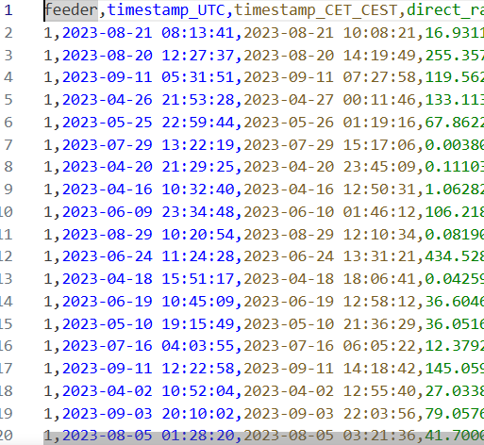
Sdv able to learn correlation trend of two columns
There is roughly a +2 hour shift between UTC and CEST.
However, it is not exact
The synthesizer tries to preserve that relationship in the synthetic data.
| Haochen Zhang | 11.05.2026

Slide 34
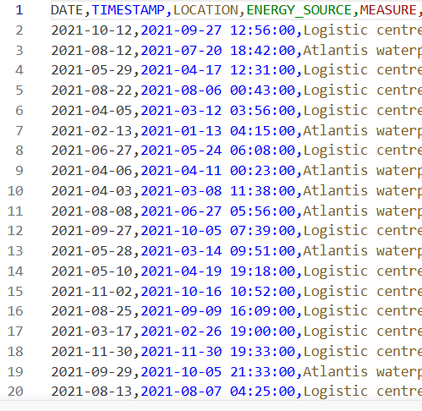
Sdv able to learn correlation trend of two columns
In this case, sdv does not learn the correlation between data and timestamp
Likely reason: the timestamp column has time.
If time is removed, sdv can generate synthetic data with same date (verified)
| Haochen Zhang | 11.05.2026

Slide 35
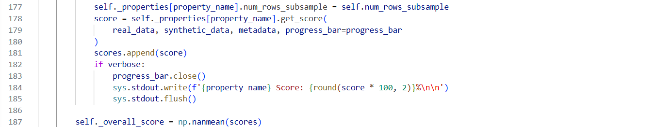
Filtered Data has higher overall score
Each property computes its own score
Some scores may be np.nan if the property cannot be computed
After all properties are evaluated, the overall score is computed as: self._overall_score = np.nanmean(scores)
Column Shapes
Column Pair Trends
*Not anonymized columns are also counted in the calculation of overall score. Example: 100% overall score with same data.
| Haochen Zhang | 11.05.2026

Slide 36
Overall Score
Column Shapes
The statistical similarity between the real and synthetic data for single columns of data. This is often called the marginal distribution of each column.
For each column:
Compare real and synthetic distribution
Compute similarity score
Average(all column scores)
Column Pair Trends
The statistical similarity between the real and synthetic data for pairs of columns. This is often called the correlation or bivariate distributions of the columns.
For each column pair:
Compare relationship in real vs synthetic data
Compute similarity score
Average(all pair scores)

Slide 37
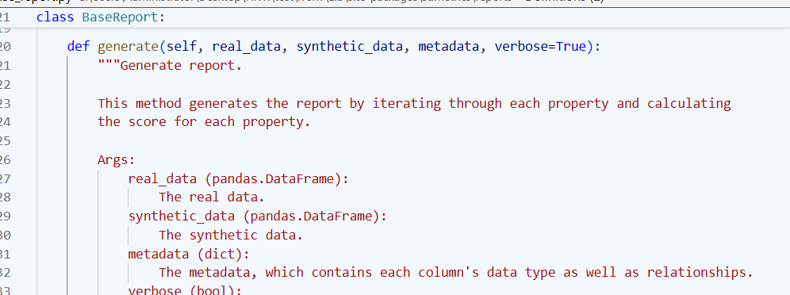
Overall score calculation

Slide 38
Related columns LLM
Related columns LLM
SMX
City, country and GPS
Actor type and RBAC
Project and service
Username and SMXtimestamp
Sampledata
Date and Timestamp
Measure, unit of measure, interval, value
Weather data
timestamp_UTC and timestamp_CET_CEST
direct_radiation_W/m2 and diffuse_radiation_W/m2
max_wind_gust_m/s, meridional_wind_m/s and zonal_wind_m/s
| Haochen Zhang | 11.05.2026

Slide 39
LLM anonymize column
| Original value | Anonymized ID | Notes |
| Atlantis waterpark | **Site_001** | Unique identifier for the waterpark site. |
| Logistic centre | **Site_002** | Unique identifier for the logistic centre. |
| Haochen Zhang | 11.05.2026

Slide 40
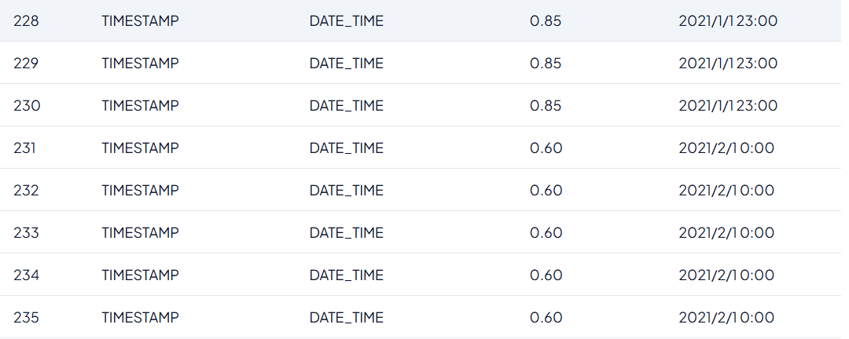
Confidence score different for same column
| Haochen Zhang | 11.05.2026

Slide 41
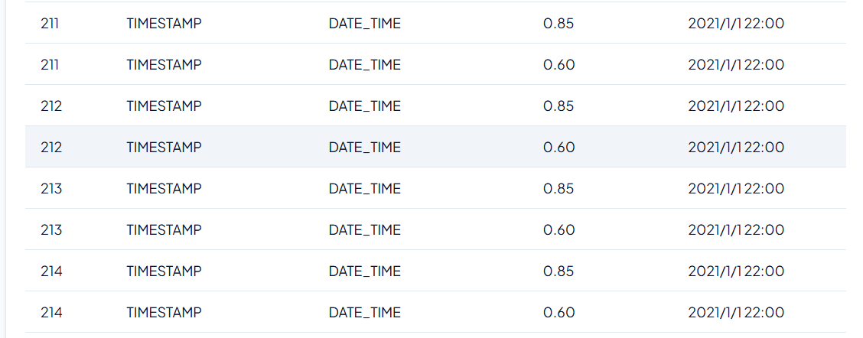
Confidence score different for same column even with same data
| Haochen Zhang | 11.05.2026

Slide 42
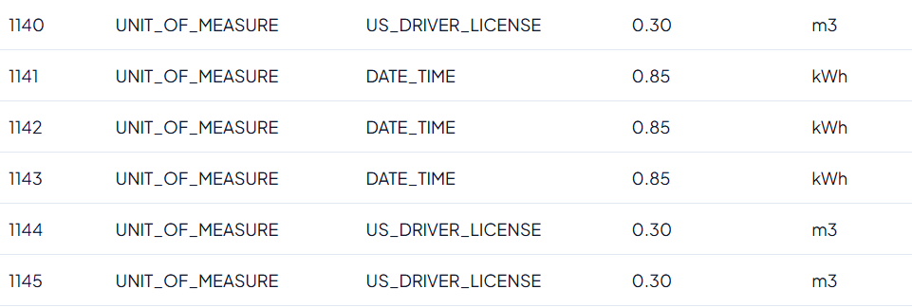
Data type false detected
| Haochen Zhang | 11.05.2026

Slide 43
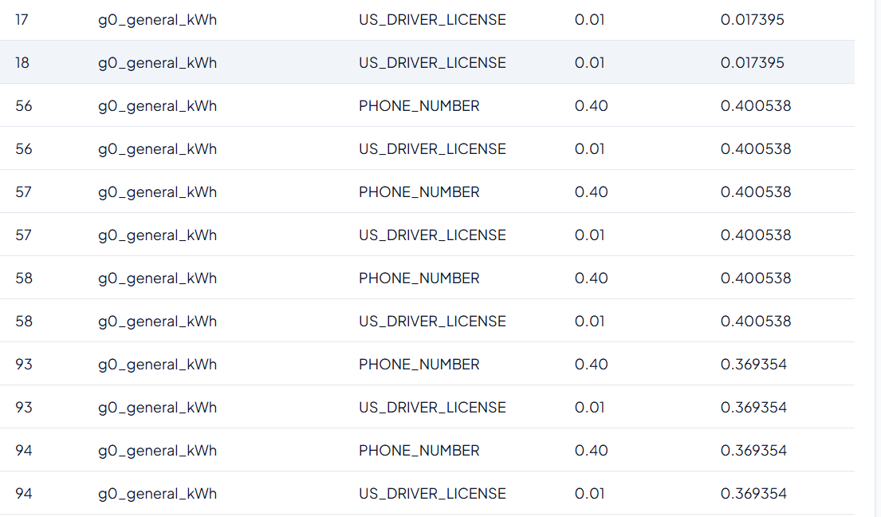
Data type false detected
| Haochen Zhang | 11.05.2026

Slide 44
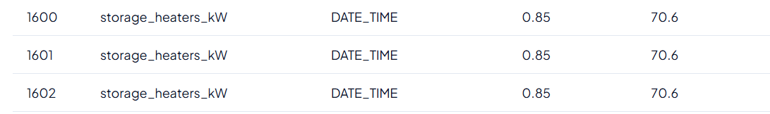
Data type false detected

Slide 45
Date preprocessing
Missing Value
Relationship between columns​

Slide 46
GridFM-Datakit
This section records the errors and bug i met, during the test of GridFM. And how to solve them

Slide 47
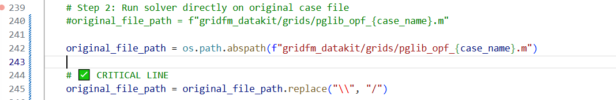
Errors
Models.parse_file("C:\Users\..."): invalid unicode escape \U
Julia cannot handle:"C:\Users\..."
\U is interpreted as a Unicode escape
Replaced \\ with / in network.py, process_network.py and solvers.py
Function fix_path(p) added in init_julia in process_network.py

Slide 48
Errors
ERROR: ArgumentError: Package PowerModels not found in current path.
Fixed by installing PowerModels in virtuell environment

Slide 49
Errors
ERROR: UndefVarError: `Models` not defined in `Main`
Caused by Models.parse_file(...) in network.py
Fixed to PowerModels.parse_file(...)

Slide 50
Input data for GridFM-Datakit
Imported from standard formats:
MATPOWER (.m files)
Input data:
Bus data
Generator Data
Branch Data

Slide 51
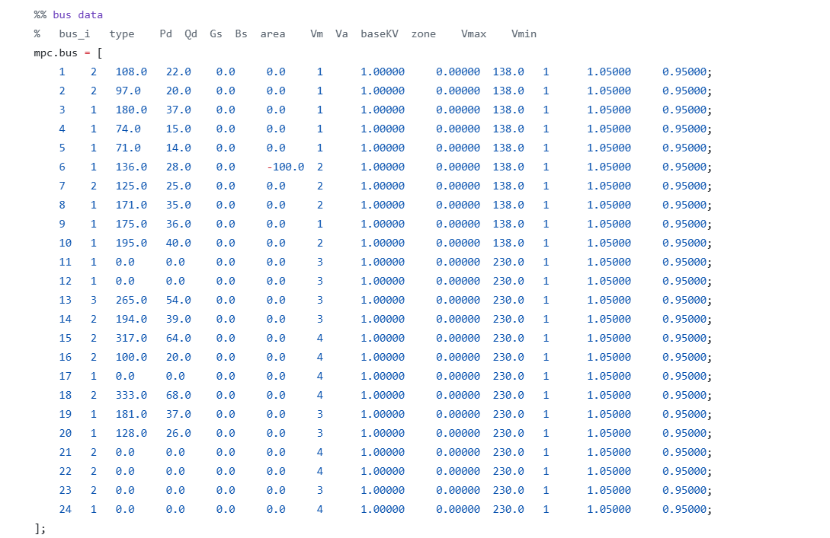
Bus data

Slide 52
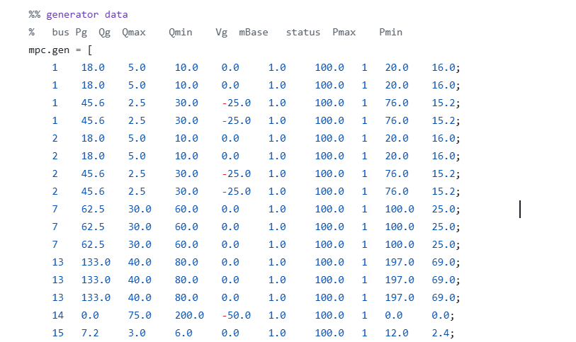
Generator Data

Slide 53
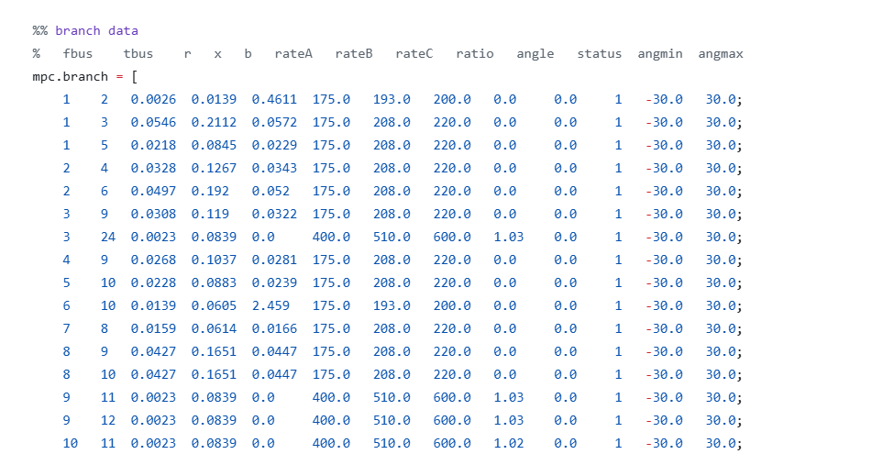
Branch Data

Slide 54
Sample Title, 2nd Version
Subtitle
Name of Speaker

Slide 55
Sample Title, 4th Version
Subtitle
Name of Speaker

Slide 56
Sample Title, 5th Version
Subtitle
Name of Speaker

Slide 57
Sample Title, 6th Version
Subtitle
Name of Speaker

Slide 58
Sample Title, 7th Version (logo of partner)
Subtitle
Name of Speaker

Slide 59
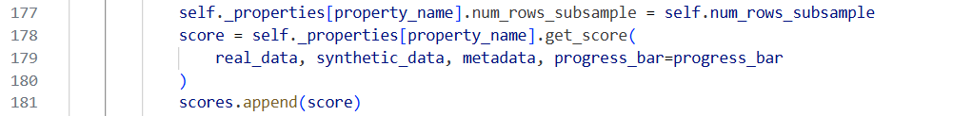
Edit the mastertitle format by clicking Example for the use of a double-spaced title

Slide 60
Edit the mastertitle format by clicking Example for the use of a double-spaced title
First Level
Second Level
Third Level
Fourth Level
Fifth Level
Picture title or description

Slide 61
Edit the mastertitle format by clicking Example for the use of a double-spaced title
First Level
Second Level
Third Level
Fourth Level
Fifth Level
Picture title or description

Slide 62
Edit the mastertitle format by clicking Example for the use of a double-spaced title
Picture title or description

Slide 63
Edit the mastertitle format by clicking Example for the use of a double-spaced title

Slide 64
Edit the mastertitle format by clicking Example for the use of a double-spaced title

Slide 65
Edit the mastertitle format by clicking Example for the use of a double-spaced title

Slide 66
Edit the mastertitle format by clicking Example for the use of a double-spaced title

Slide 67
Contact
E.ON Energy Research Center
Mathieustraße 10
52074 Aachen
Germany
FIRST NAME SURNAME
T +49 241 80 49xxx
F +49 241 80 49xxx
xxx@eonerc.rwth-aachen.de
Further Information:
http://www.eonerc.rwth-aachen.de

Slide 68
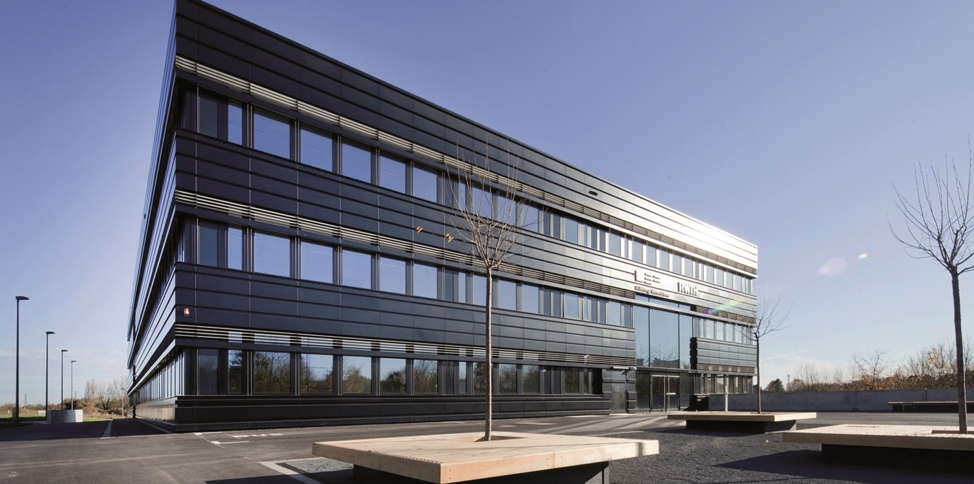
Contact
E.ON Energy Research Center
Mathieustraße 10
52074 Aachen
Germany
FIRST NAME SURNAME
T +49 241 80 49xxx
F +49 241 80 49xxx
xxx@eonerc.rwth-aachen.de
http://www.eonerc.rwth-aachen.de

Slide 69
Contact
E.ON Energy Research Center
Mathieustraße 10
52074 Aachen
Germany
FIRST NAME SURNAME
T +49 241 80 49xxx
F +49 241 80 49xxx
xxx@eonerc.rwth-aachen.de
Further Information:
http://www.eonerc.rwth-aachen.de

Slide 70
Thanks to our partner.
Thanks to our partner
Thanks to our partner
Thanks to our partner
Thanks to our partner

Slide 71
Thanks to our partner
Thanks to our partner
Thanks to our partner
Thanks to our partner
Thanks to our partner
Thanks to our partner

